Slide 1
IMPLEMENTATION OF Queues Data Structures & Algorithms (CSC211)

Slide 2
Queue
Stores a set of elements in a particular order
principle: FIRST IN FIRST OUT= FIFO
It means: the first element inserted is the first one to be removed
The first one in line is the first one to be served
cinemark

Slide 3
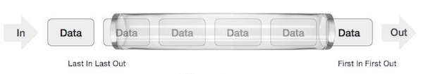
Queues
A stack is LIFO (Last-In First Out) structure.
In contrast, a queue is a FIFO (First-In First-Out ) structure.
A queue is a linear structure for which items can be only inserted at one end and removed at another end.
We have two Ends (Front and rear)

Slide 4
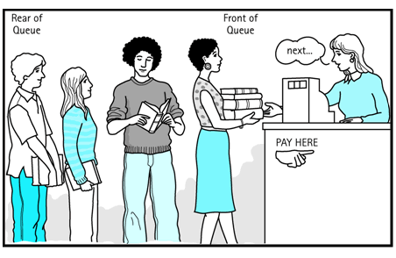
Queue Applications
Real life examples
Waiting in line
Waiting on hold for tech support
Applications related to Computer Science
Access to shared resources (e.g. printer)
Job scheduling
Keyboard Buffer

Slide 5
A QUEUE IS A CONTAINER IN WHICH:
INSERTIONS ARE MADE ONLY AT
THE BACK;
DELETIONS, RETRIEVALS, AND
MODIFICATIONS ARE MADE ONLY
AT THE FRONT.

Slide 6
The Queue
A Queue is a FIFO (First in First Out) Data Structure. Elements are inserted in the Rear of the queue and are removed at the Front.

Slide 7
PUSH (ALSO CALLED ENQUEUE) -- TO INSERT AN ITEM AT THE BACK
POP (ALSO CALLED DEQUEUE) -- TO DELETE THE FRONT ITEM
IN A QUEUE, THE FIRST ITEM INSERTED WILL BE THE FIRST ITEM DELETED: FIFO (FIRST-IN, FIRST-OUT)

Slide 8
Enqueue and Dequeue
Primary queue operations: Enqueue and Dequeue
Like check-out lines in a store, a queue has a front and a rear.
Enqueue
Insert an element at the rear of the queue
Dequeue
Remove an element from the front of the queue
Remove (Dequeue)
Insert (Enqueue)
front
rear

Slide 9
Implementing Queue
Using linked List:
front
rear
front
rear
1
7
5
2
1
7
5
2

Slide 10
Implementing Queue
Using linked List:
front
rear
front
rear
1
7
5
2
1
7
5
2
dequeue()
front
rear
front
rear
7
5
2
1
7
5
2

Slide 11
Implementing Queue
Using linked List:
front
rear
front
rear
1
7
5
2
1
7
5
2
enqueue(9)
front
rear
front
rear
7
5
2
9
7
5
2
9

Slide 12
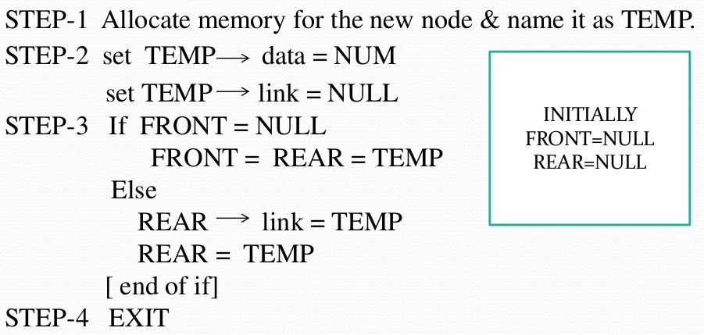
Algorithm To Insert an Element In Queue using Linked list

Slide 13
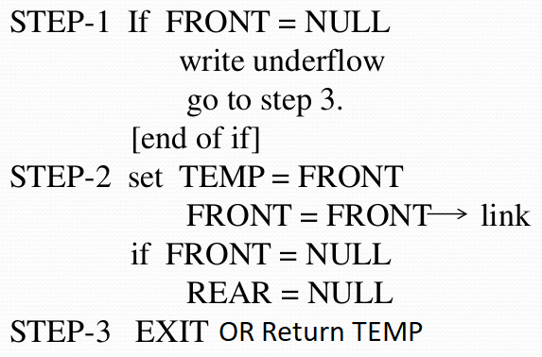
Algorithm To Delete an Element In Queue using Linked list

Slide 14
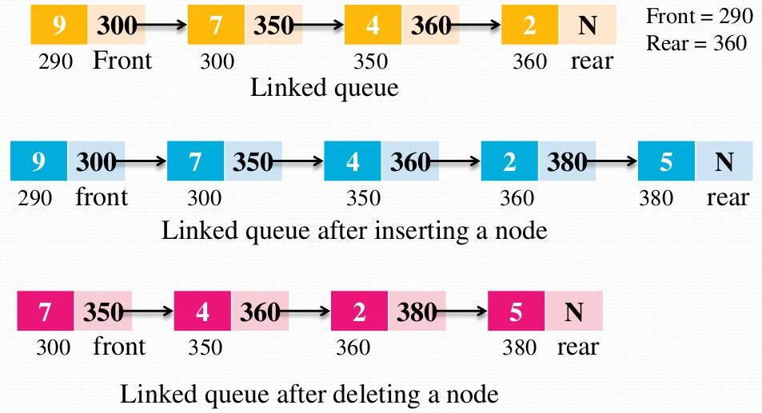
Queues using linked list

Slide 15
Queue using Array
If we use an array to hold queue elements, both insertions and removal at the front (start) of the array are expensive.
This is because we may have to shift up to “n” elements.
For the stack, we needed only one end; for queue we need both.
To get around this, we will not shift upon removal of an element.

Slide 16
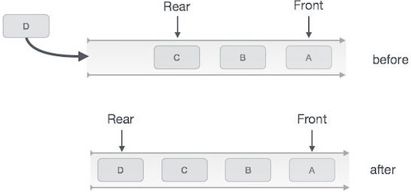
Algorithm Enqueue
int enqueue(int data)
if(isfull())
return 0;
rear = rear + 1;
queue[rear] = data;
return 1;
end procedure
Step 1 − Check if queue is full.
Step 2 − If queue is full, produce overflow
error and exit.
Step 3 − If queue is not full, increment rear pointer to point next empty space.
Step 4 − Add data element to the queue location, where rear is pointing.
Step 5 − return success.

Slide 17
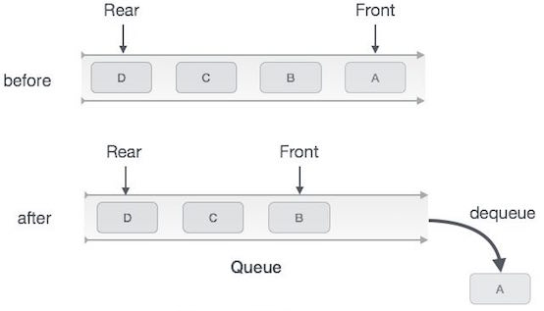
Algorithm Dequeue
int dequeue() {
if(isempty())
return 0;
int data = queue[front];
front = front + 1;
return data;
}
Step 1 − Check if queue is empty.
Step 2 − If queue is empty,
produce underflow error and exit.
Step 3 − If queue is not empty, access data where front is pointing.
Step 3 − Increment front pointer to point next available data
element.
Step 5 − return success.

Slide 18
Example-Queue using Array
front
rear
1
7
5
2
1
7
5
2
0
1
2
3
4
5
6
7
front
rear
0
3

Slide 19
Example-Queue using Array
enqueue(6)
front
rear
1
7
5
2
6
1
7
5
2
6
0
1
2
3
4
5
6
7
front
rear
0
4

Slide 20
Example-Queue using Array
enqueue(8)
front
rear
1
7
5
2
6
8
1
7
5
2
6
8
0
1
2
3
4
5
6
7
front
rear
0
5

Slide 21
Example-Queue using Array
dequeue()
front
rear
7
5
2
6
8
7
5
2
6
8
0
1
2
3
4
5
6
7
front
rear
1
5

Slide 22
Example-Queue using Array
dequeue()
front
rear
5
2
6
8
5
2
6
8
0
1
2
3
4
5
6
7
front
rear
2
5

Slide 23
Example-Queue using Array
enqueue(9)
enqueue(12)
front
rear
5
2
6
8
9
12
5
2
6
8
9
12
0
1
2
3
4
5
6
7
front
rear
enqueue(21) ??
2
7

Slide 24
Queue using Array
We have inserts and removal running in constant time but we created a new problem.
Cannot insert new elements even though there are two places available at the start of the array.
Solution: allow the queue to “wrap around”.

Slide 25



Queue using Array
For example, consider a queue 'Q' that can hold a maximum of four elements. Initially the queue contains three elements A, B and C as shown below:
When elements A and B are deleted, the queue will be as shown below:
In the above queue, the values of R and F are same. Only one element can be added into the queue in this state. For example, when an element D is added, the queue will be as shown below:

Slide 26
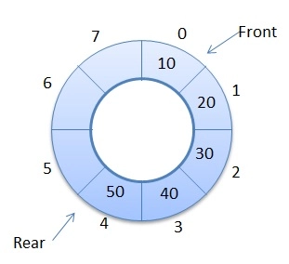
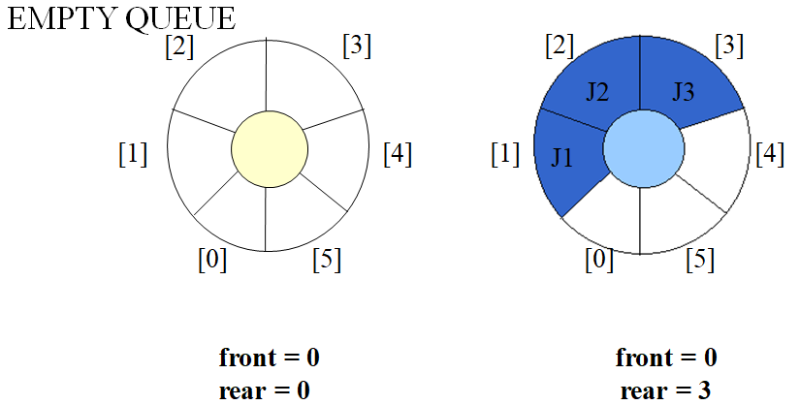
Circular Queues
Circular Queue are used to remove the drawback of simple Queues
Both the front and rear wrap around to the beginning of the array
It is also called a “Ring Buffer”

Slide 27
Queue using Array
Basic idea is to picture the array as a circular array.
0
1
front
rear
front
7
2
2
12
5
5
2
6
8
9
12
6
9
2
8
6
3
rear
5
4
7

Slide 28
Queue using Array
enqueue(21)
0
1
front
rear
21
front
size
7
2
2
8
12
5
5
2
6
8
9
12
21
6
9
2
8
6
3
rear
noElements
5
4
0
7
rear = (rear +1) % size

Slide 29
Queue using Array
enqueue(7)
0
1
front
rear
21
7
front
size
7
2
2
8
12
5
5
2
6
8
9
12
21
7
6
9
2
8
6
3
rear
noElements
5
4
1
8
int isFull()
{
return noElements == size;
}
int isEmpty()
{
return noElements == 0;
}

Slide 30
Queue using Array
dequeue()
0
1
front
rear
21
7
front
size
7
2
3
8
12
6
8
9
12
21
7
6
9
2
8
6
3
rear
noElements
5
4
1
6

Slide 31
Queue using Array
dequeue()
0
1
front
rear
21
7
front
size
7
2
4
8
12
6
8
9
12
21
7
6
9
8
6
3
rear
noElements
5
4
1
6

Slide 32
Implementation
public class CircularArrayQueue {
private final int DEFAULT_CAPACITY = 100;
private int front, rear, noElements, size;
private int[ ] queue;
//---- // Creates an empty queue using the default capacity. //------//
public CircularArrayQueue() {
front = rear = -1;
noElements = 0;
size = DEFAULT_CAPACITY;
queue = new int[size]); }
//--- // Creates an empty queue using the specified capacity. //----//
public CircularArrayQueue (int initialCapacity) {
front = rear = -1;
noElements = 0;
size = initialCapacity
queue = new int[size]; }

Slide 33
Implementation - Enqueue
//-----// Adds the specified element to the rear of the queue, expanding the capacity of the queue array if necessary. //-----//
public boolean enqueue (int element) {
if (isFull()) {
System.out.println(“Queue is full”);
return false;
}
if(isEmpty()) {
front = (front +1) % size
}
rear = (rear+1) % size ;
queue[rear] = element
noElements++; return true;
}
public boolean isFull(){
if(noElements == size) return true;
else return false;
}

Slide 34
Implementation - Denqueue
//----// Removes the element at the front of the queue and returns a reference to it. Return 0 if the queue is empty. //----//
public int dequeue() {
if (isEmpty()){
System.out.println(“Queue is empty”);
return 0;
}
int result = queue[front];
if(front == rear) { //queue has only one element
front = rear = -1; noElements--;
return result;
}
front = (front+1) % size;
noElements--; return result;
}
public boolean isEmpty(){
if(noElements == 0) return true;
return false
} }

Slide 35
Write Display Function

Slide 36
Priority Queue
Let’s take the example of traffic. Traffic is stopped at the signal.
The vehicles are in a queue. When the signal turns green, vehicles starts moving. The vehicles which are at the front of the queue will cross the crossing first.
Suppose an ambulance comes from behind. Here ambulance should be given priority. It will bypass the queue and cross the intersection.

Slide 37
Priority Queue
Sometimes, we have queues that are not FIFO i.e. the person who comes first may not leave first.
There may be some priority.
You will see the priority queue being used at many places especially in the operating systems.
In operating systems, we have queue of different processes. If some process comes with higher priority, it will be processed first.

Slide 38
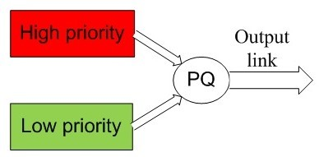
Priority Queue
In priority queue inserting and removing of elements is decided by the priority of elements
An element of higher priority is processed first
Two elements of same priority are processed on first-come-first-serve bases

Slide 39
Priority Queue - Implementation
Can be implemented using an array, a linked list, a heap data structure or a binary search tree
Each entry is a pair (key, value).
Key: used to identify or weigh that element.
Two distinct entries in a priority queue can have the same key.

Slide 40
Main methods of Priority Queue ADT
size():
Return the number of entries in the queue.
isEmpty():
Test whether the queue is empty.
min():
Return (do not remove) an entry with smallest key.
insert(k, x):
Insert an entry with key k and value x.
removeMin():
Remove and return the entry with smallest key.

Slide 41
Priority Queue - Implementation
With an unsorted list :
4
5
2
3
1
insert() – adds entry at last -> takes O(1)
removeMin() – requires complete scan -> takes O(n)
“fast insertion and slow removal”

Slide 42
With a Sorted List : based on key
Priority Queue - Implementation
1
2
3
4
5
Insert() – requires complete scan -> takes O(n)
removeMin() – always access the first element -> takes O(1)
fast removal and slow insertions.

Slide 43
Priority Queue Application
Dijkstra’s Shortest Path Algorithm using priority queue:
Data compression.
Heap Sort

